Slide 1
Opening Grounds: Using Data to Find And Design Your First Coffee Shop Location in the US
Prepared by: Jerry Mar
Prepared For: coffee shop owners

Slide 2
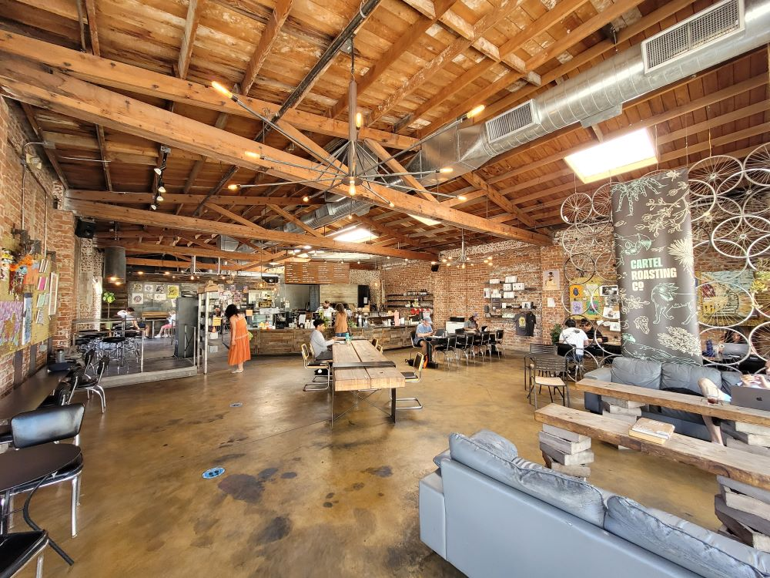
Presentation Background
The US coffee shop industry has experienced significant growth in the last 5 years
Daily Coffee News reports that US coffee shop market surpassed 40,000 stores
IBISWorld estimates that the US coffee shop market has annualized growth rate of 6.9%, shooting revenues up to $74.3 billion over the five years to 2025
With the rapid growth of coffee shop market and the large number of existing cafés, opening a new shop in the US has become highly competitive.
New businesses often face challenges such as market saturation and designing a coffee shop that stands out through features and atmosphere.
Notes:
https://dailycoffeenews.com/2023/10/24/led-by-big-chains-us-coffee-shop-market-surpasses-40000-stores/
https://www.ibisworld.com/united-states/industry/coffee-snack-shops/1973/#:~:text=Coffee%20&%20Snack%20Shops%20in%20the%20US%20industry%20analysis,the%20five%20years%20to%202025.

Slide 3
Presentation Purpose and Deliverables
This presentation uses real Yelp data to identify:
U.S. cities with the highest potential for opening a new coffee shop
Key features that contribute to the success of existing coffee shops
Deliverables include:
Top 10 U.S. cities for new coffee shop opening
K-means clustering model to group top 10 cities based on market characteristics
Success factors for coffee shops

Slide 4
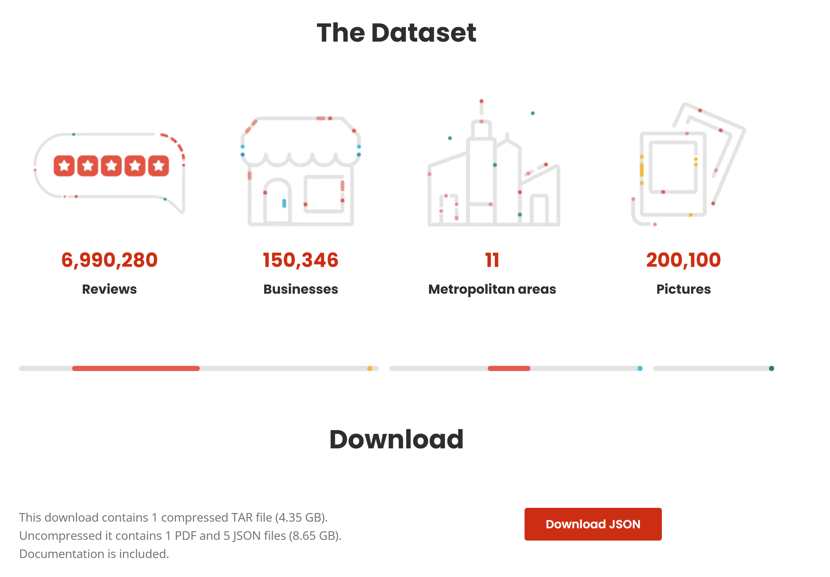
Data source: Yelp
The Yelp Open Dataset is a subset of Yelp data that is intended for educational use. It provides real-world data related to businesses including reviews, photos, check-ins, and attributes like hours, parking availability, and ambience.
Data was extracted, cleaned, and transformed using Python (Pandas & Numpy)
Notes:
https://business.yelp.com/data/resources/open-dataset/

Slide 5
Deliverable 1
Determine top 10 cities to open a coffee shop

Slide 6
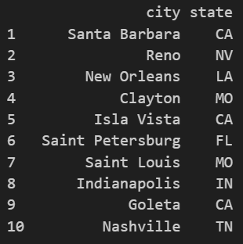
Top 10 Cities To Open a Coffee Shop
Opportunity score was used to determine the top 10 cities to open a coffee shop
The score depends on median check-ins, ratings, reviews, % population ages 25-39, and coffee shop density for each city
Check-ins = foot traffic
Ratings = customer satisfaction
Reviews = customer engagement
% population ages 25-39 = city potential
Coffee shop density = saturation
Top 10 City Results
$$Opportunity score =confidence weight ∗(0.4∗{med}_{check−ins}+0.15∗{med}_{ratings}+0.15∗{med}_{review}+0.1∗{population}_{ages 25−39}$$
$$−0.2∗density_{shops per 10k residents})$$

Slide 7
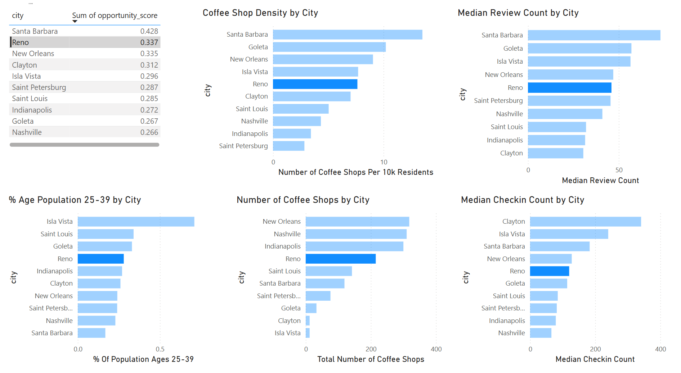
Open a Coffee Shop in Reno, NV
Although Santa Barbara ranked first, Reno stands out as a promising alternative.
It has a lower coffee shop density, which may signal less competition.
It also has a higher percentage of younger residents, suggesting strong potential demand.
Additionally, the cost of opening a shop in Reno is significantly lower than in Santa Barbara.
While Reno ranks middle of the pack in many other metrics, this balance indicates a well-rounded market with solid customer engagement.
If I had to recommend 1 city to open a coffee shop in, it would be Reno, NV.

Slide 8
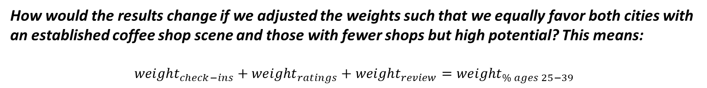
Additional Insight: Readjust Weights
How would the results change if we adjusted the weights such that we equally favor both cities with an established coffee shop scene and those with fewer shops but high potential? This means:
$${weight}_{check−ins}+{weight}_{ratings}+{weight}_{review}={weight}_{\% ages 25−39}$$
Original Weight Criteria
1. Median check-in count = 0.4
2. Median stars= 0.15
3. Median review counts = 0.15
4. Ages 25-39 % = 0.1
5. shops_per_10k_residents = 0.2
New Weight Criteria
1. Median check-in count = 0.22
2. Median stars= 0.09
3. Median review counts = 0.09
4. Ages 25-39 % = 0.4
5. shops_per_10k_residents = 0.2
Shop density, average stars, and average review count now have the same weight

Slide 9
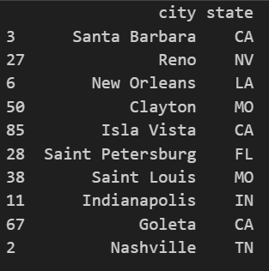
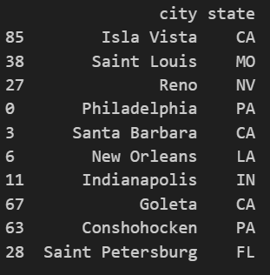
Additional Insight: Readjust Weights Results
Original Weight Results
New Weight Results
8 of the top 10 cities remain the same after adjusting the weights

Slide 10
Deliverable 2
K-means clustering model to group similar cities based on market characteristics

Slide 11
Grouping Cities with Similar Characteristics
We used a KMeans model to group the top 10 cities into clusters
This helps us spot which cities are most similar. So, if one city is doing well, we can consider opening a shop in a similar one.
We used the following input features:
1. Coffee shop density per 10k residents
this indicates competition
2. % of population in ages 25-39
this represents demand and potential
3. median household income
this represents viability.
Can the economics work? Are customers likely to afford frequent purchases?

Slide 12
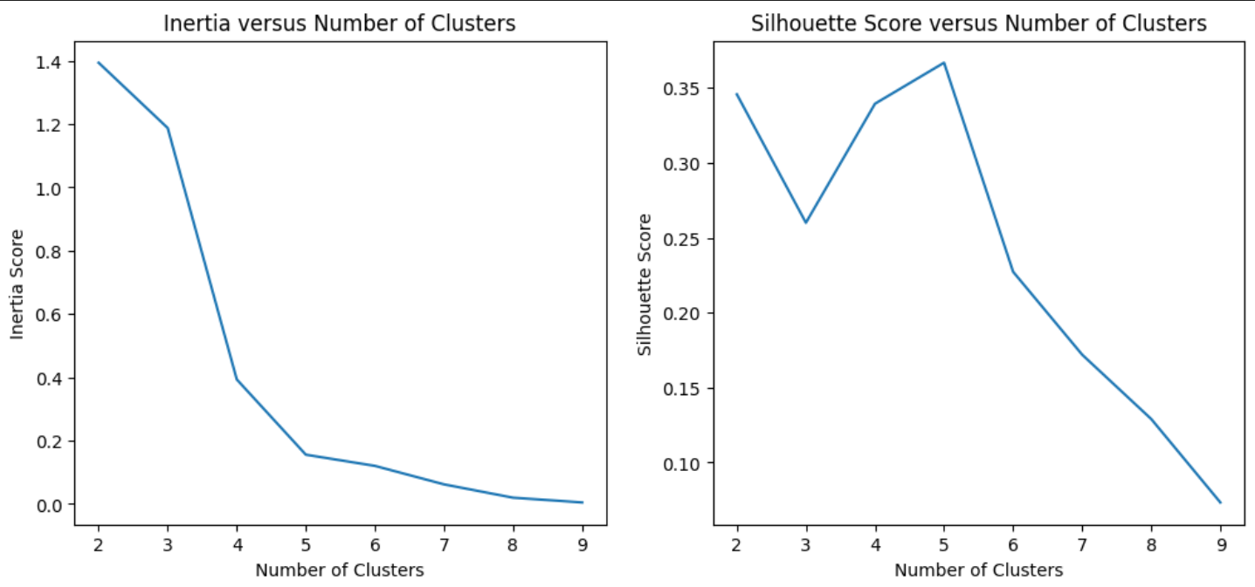
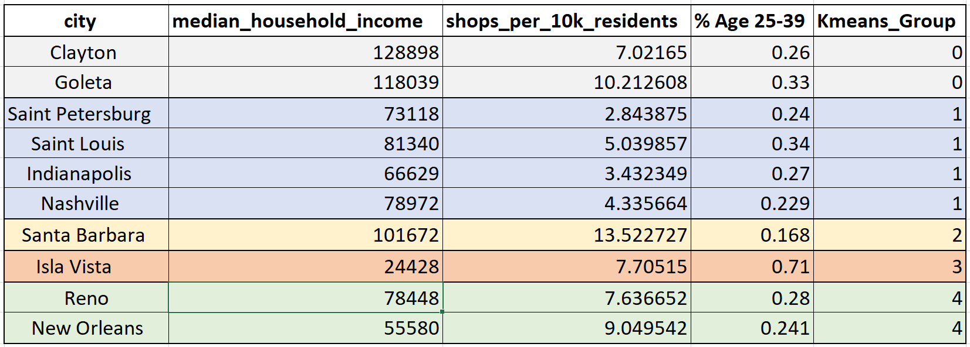
KMeans model results: 5 groups
KMeans model results show that 5 groups is the optimal number of groups
The silhouette curve shows that the silhouette scores are low, which suggests that each group of points are not really densely packed
Santa Barbara and Isla Vista were the only cities in their group, which suggests that they are outlier cities with unique characteristics.
Since Santa Barbara ranked as the top city to open a coffee shop, this may imply that expanding within the same city—rather than choosing a similar one—could be a better strategy.

Slide 13
Grouping Cities Next Steps
Gather more data on population growth over the last 5 years and average rent to better identify and separate the cities.
Consider modeling more than just the top 10 cities since some of the top 10 cities had only 1 city in the group.
Next steps identified to improve KMeans model performance

Slide 14
Deliverable 3
Determine factors that contribute to a successful coffee shop

Slide 15
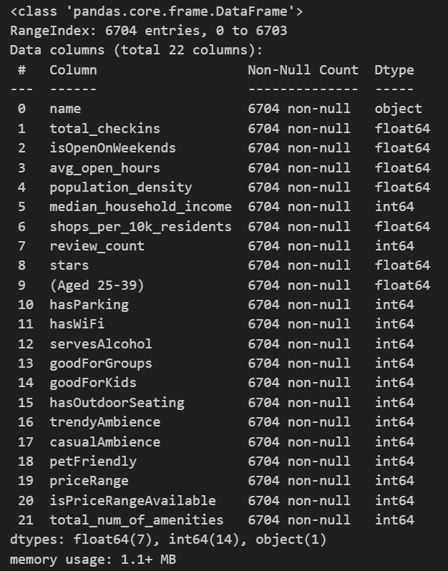
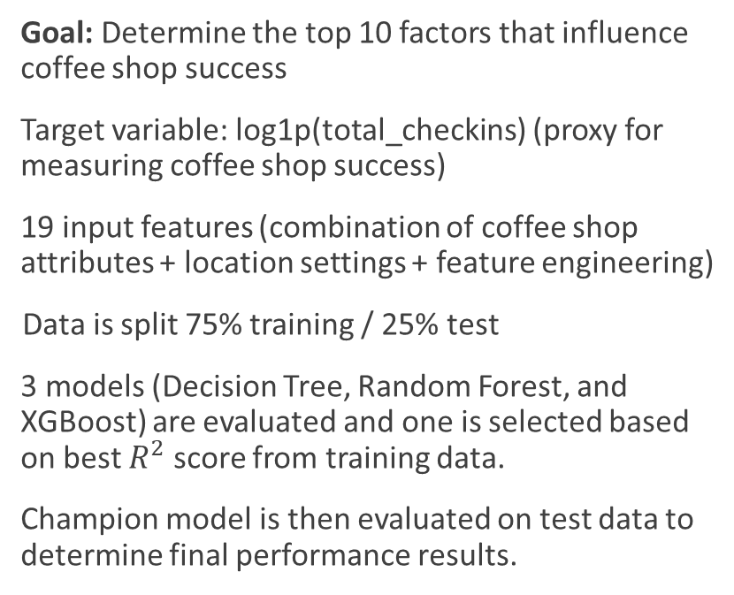
ML Models for Coffee Shop Success Factors
Goal: Determine the top 10 factors that influence coffee shop success
Target variable: log1p(total_checkins) (proxy for measuring coffee shop success)
19 input features (combination of coffee shop attributes + location settings + feature engineering)
Data is split 75% training / 25% test
3 models (Decision Tree, Random Forest, and XGBoost) are evaluated and one is selected based on best $R^{2}$ score from training data.
Champion model is then evaluated on test data to determine final performance results.
The total_checkins is right-skewed so we take log1p(total_checkins) to reduce the effect of outliers on the model

Slide 16
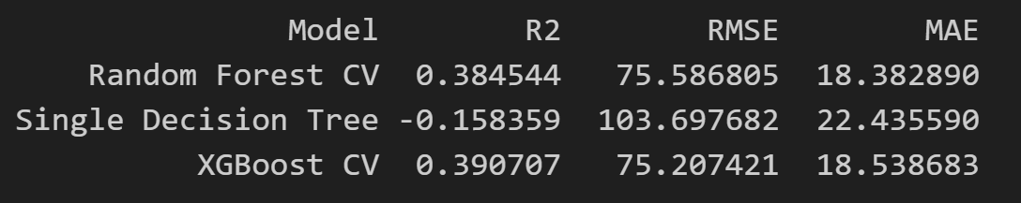
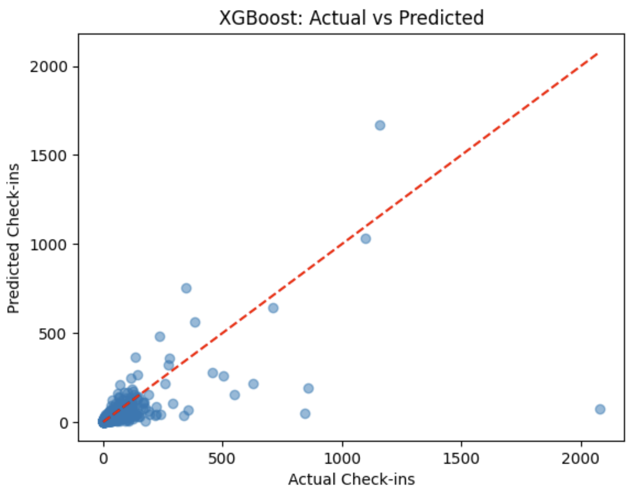
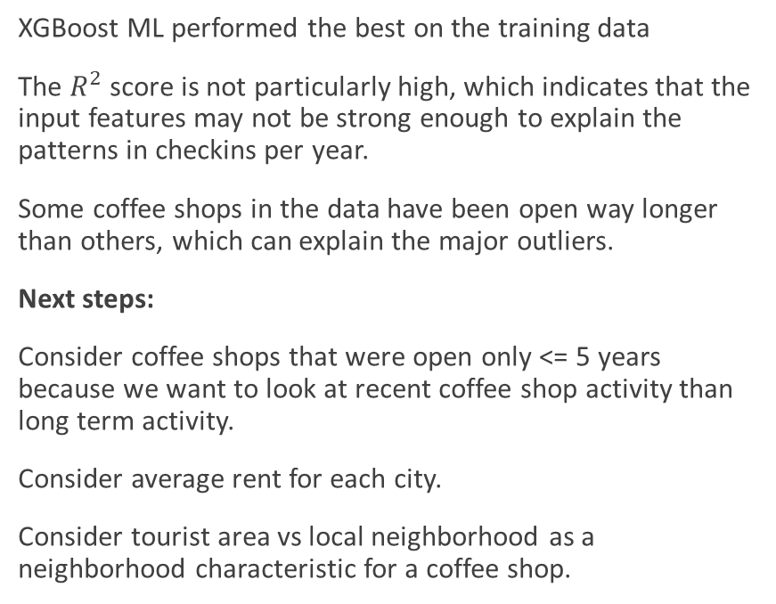
ML Models Results
XGBoost ML performed the best on the training data
The $R^{2}$ score is not particularly high, which indicates that the input features may not be strong enough to explain the patterns in checkins per year.
Some coffee shops in the data have been open way longer than others, which can explain the major outliers.
Next steps:
Consider coffee shops that were open only <= 5 years because we want to look at recent coffee shop activity than long term activity.
Consider average rent for each city.
Consider tourist area vs local neighborhood as a neighborhood characteristic for a coffee shop.
Training data results
XGBoost performed the best

Slide 17
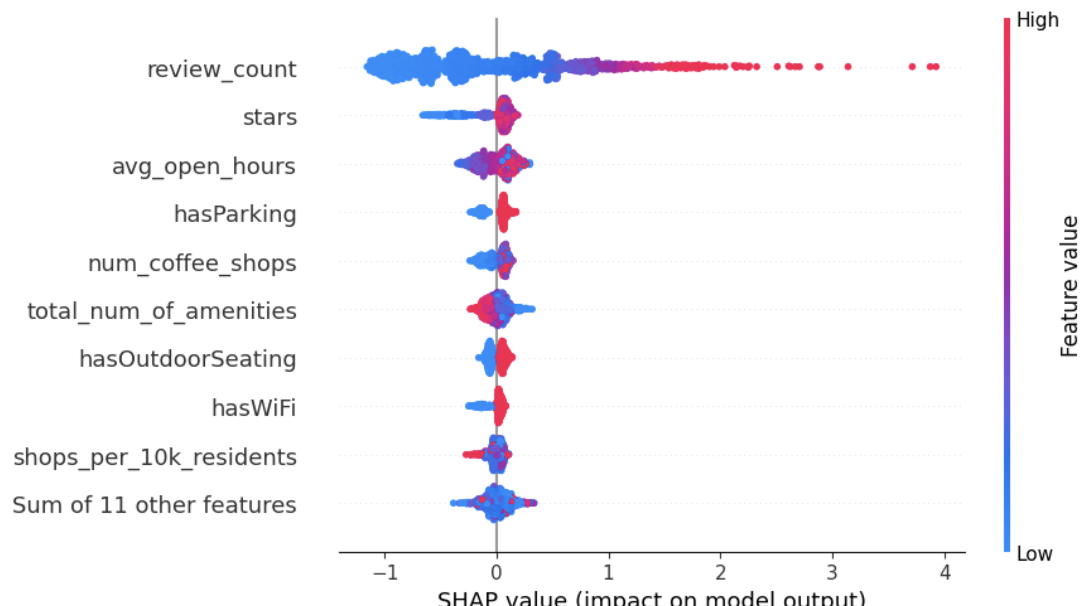
SHAP Insights for Success Factors
SHAP values tells how much each feature contributed to each individual prediction
So review count has the highest largest average influence on predictions of check ins. It was also the most frequently used feature across trees (according to XGBoost’s weight importance score)
Features like avg_open_hours, total_num_of_amenities, hasOutdoorSeating and hasParking also pushed predictions upwards, suggesting that shops with longer hours, outdoor seating, more amenities, and better accessibility see more foot traffic.
Interestingly, coffee shop density showed a split effect – possibly reflecting how dense areas reflect more competition, while others can reflect more opportunity
SHAP values
Coffee shops tend to be more successful when they have a high number of reviews, stay open longer, offer more amenities, have outdoor seating, and are easy to access.

Slide 18
Backup

